Slide 1

Predicting Diabetes Risk with Machine Learning
Jeffery Richardson
Grand Canyon University
DSC-590 – Model Insight and Validation

Slide 2
Project Purpose
• Address rising diabetes prevalence
• Support early clinical intervention
• Evaluate predictive modeling effectiveness

Slide 3
Dataset Description
• 768 patient records
• 8 clinical predictor variables
• Binary diagnostic outcome
• Structured healthcare dataset

Slide 4
Data Preparation
• Median imputation for invalid zero values
• Standard feature scaling
• 80/20 train-test split
• 5-fold cross-validation

Slide 5
Models Evaluated
• Logistic Regression
• Random Forest Classifier
• Support Vector Machine
• GridSearch hyperparameter tuning

Slide 6

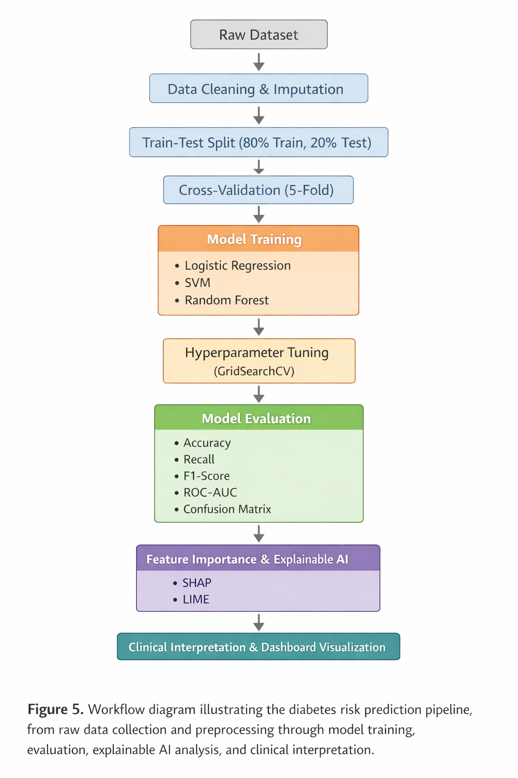
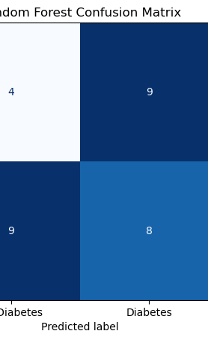
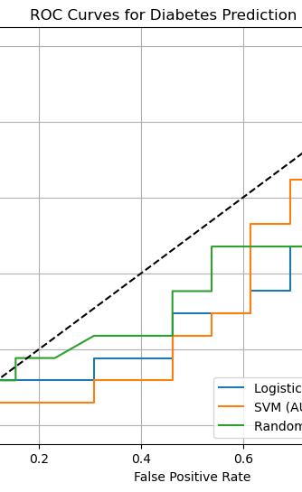
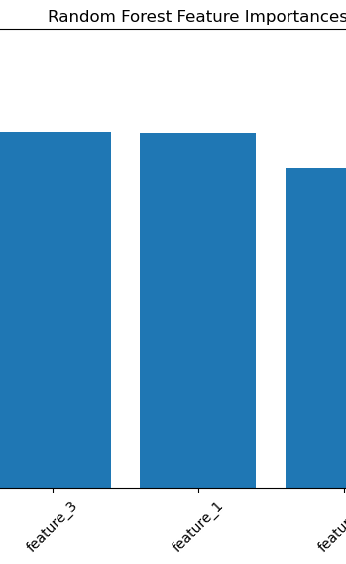
Models of the dataset

Slide 7
Model Performance
• Random Forest Accuracy: 83%
• ROC-AUC: 0.87
• Improved sensitivity
• Balanced precision-recall

Slide 8
Key Predictors
• Glucose concentration
• Body Mass Index
• Age
• Insulin levels

Slide 9
Interpretation
• Ensemble learning improved prediction
• Nonlinear patterns captured effectively
• Clinical screening potential demonstrated

Slide 10
Limitations
• Limited sample size
• Single-population dataset
• No external validation dataset

Slide 11
Future Directions
• Broader population validation
• Explainable AI integration
• Deployment within EHR systems
• Continuous bias monitoring

